Slide 1

Enhancing Sales Performance and Maximizing Market Share by Strategic Sales Analysis
AREEBA FAROOQUI [22f1001053] [MAY 2024 TERM]
BUSINESS DATA MANAGEMENT
PROJECT PRESENTATION

Slide 2
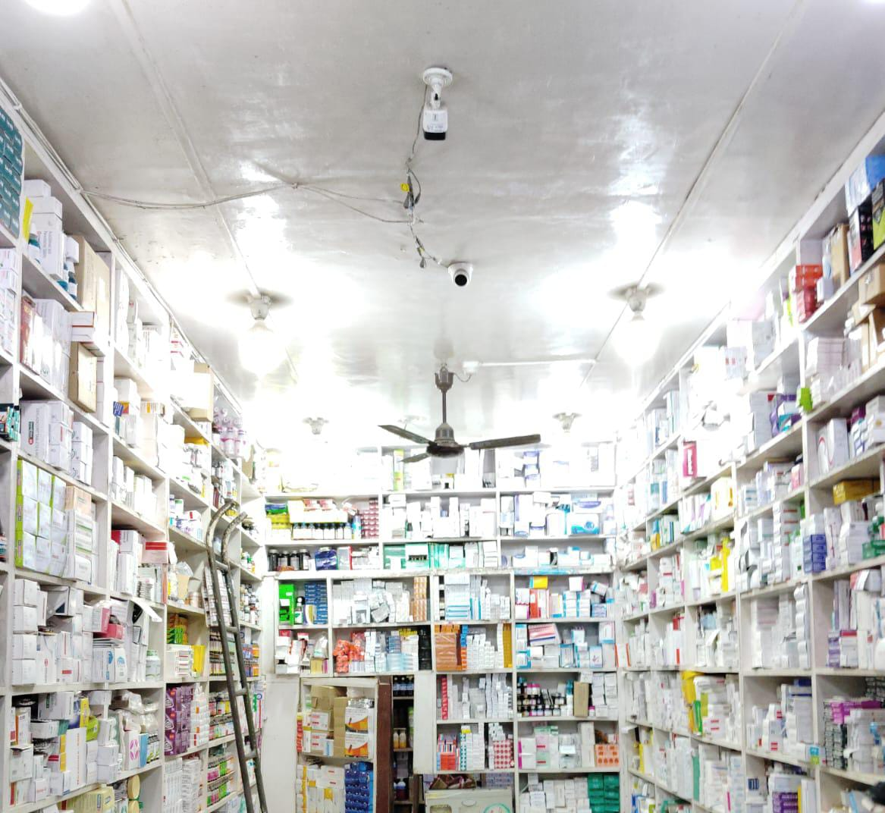
Introduction
The Bombay Medical Store is a well known medicine center located in Fatehpur (U.P.). It’s a B2B business that deals with different firms/stores and provide them with products on time.
They specialize in best quality and wide variety of pharmaceutical products and healthcare essentials .
Renowned for its exceptional quality standards, it has gained a reputation for reliability and excellence in healthcare provision in Fatehpur market and plan on continuing to provide the same quality products throughout the time

Slide 3
About the Store
The Bombay Medical Store, located in Fatehpur (U.P.) was started in 1992 by late Mr. Praveen Rastogi and is currently operated by his son Mr. Karan Rastogi.
It is renowned for its distribution of various famous products of renowned brands like Ciplox (Cipla), Augmentin(GSK), Gudcef(Mankind), Zemcifer-XT(Zuentus), Calcing-HD(Akumentis) and many more.
It operates across multiple locations throughout the city, providing a comprehensive supply of all its products.

Slide 4
Descriptive
Statistics
Average Products Sold: The average number of products sold from October 2023 to March 2024 is 245 in total.
Unique Products: The store provides an overall total of 3024 unique products which indicate their high range of products in the inventory.
Number of Firms: There are a total of 144 unique firms/shops from where the orders are placed and the products are sent to them as soon as possible.
Average Invoice Value: The average invoice value of all the months from October 2023 to March 2024 is Rs.6374.70
Most Demanded Product: In this wide variety of products, the product which is sold the highest number of times is BUDECART RESP.5 which is sold 77935 units in all over these six months.
Maximum Invoices: The maximum number of products are sent to SHIVAM MEDICAL STORE from BOMBAY MEDICAL STORE in these six months and the number of invoices made for the same is 423.

Slide 5
The PDM:
Problems
Data Overview
Methodology
P: INVENTORY MANAGEMENT
Enhancing sales performance through Sales Data Analysis, Improving Inventory Management, Increasing Customer Base.
D : Data Collected [Oct 2023 – Mar 2024]
Sales Data of the total products sold in six months, Invoice data for the 144 stores to which the products are sold.
M : Analysis and Methods
Pareto Analysis, ABC Analysis, RFM Analysis and SWOT Analysis.

Slide 6
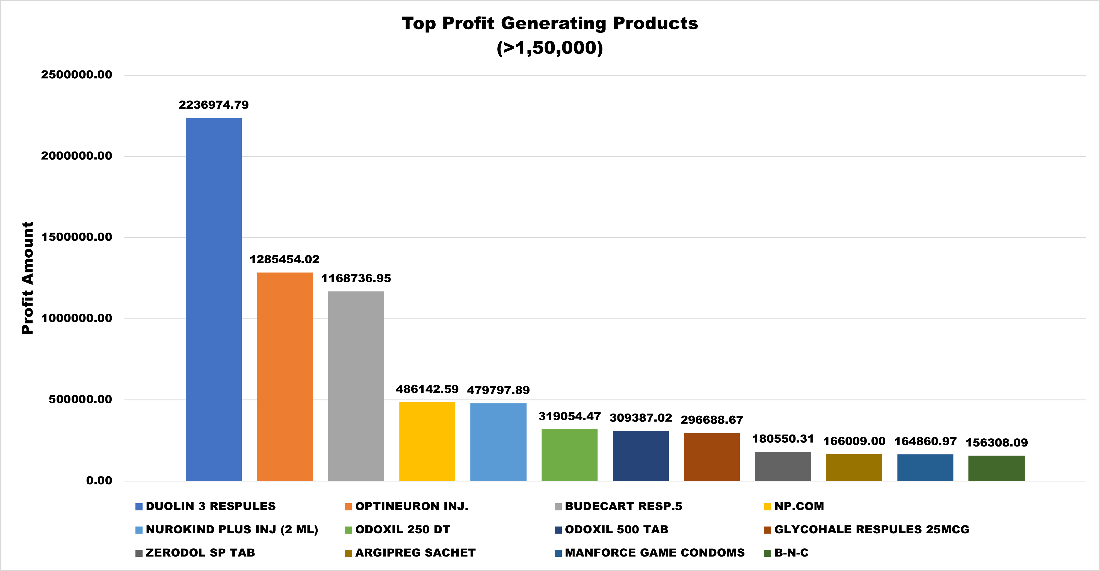
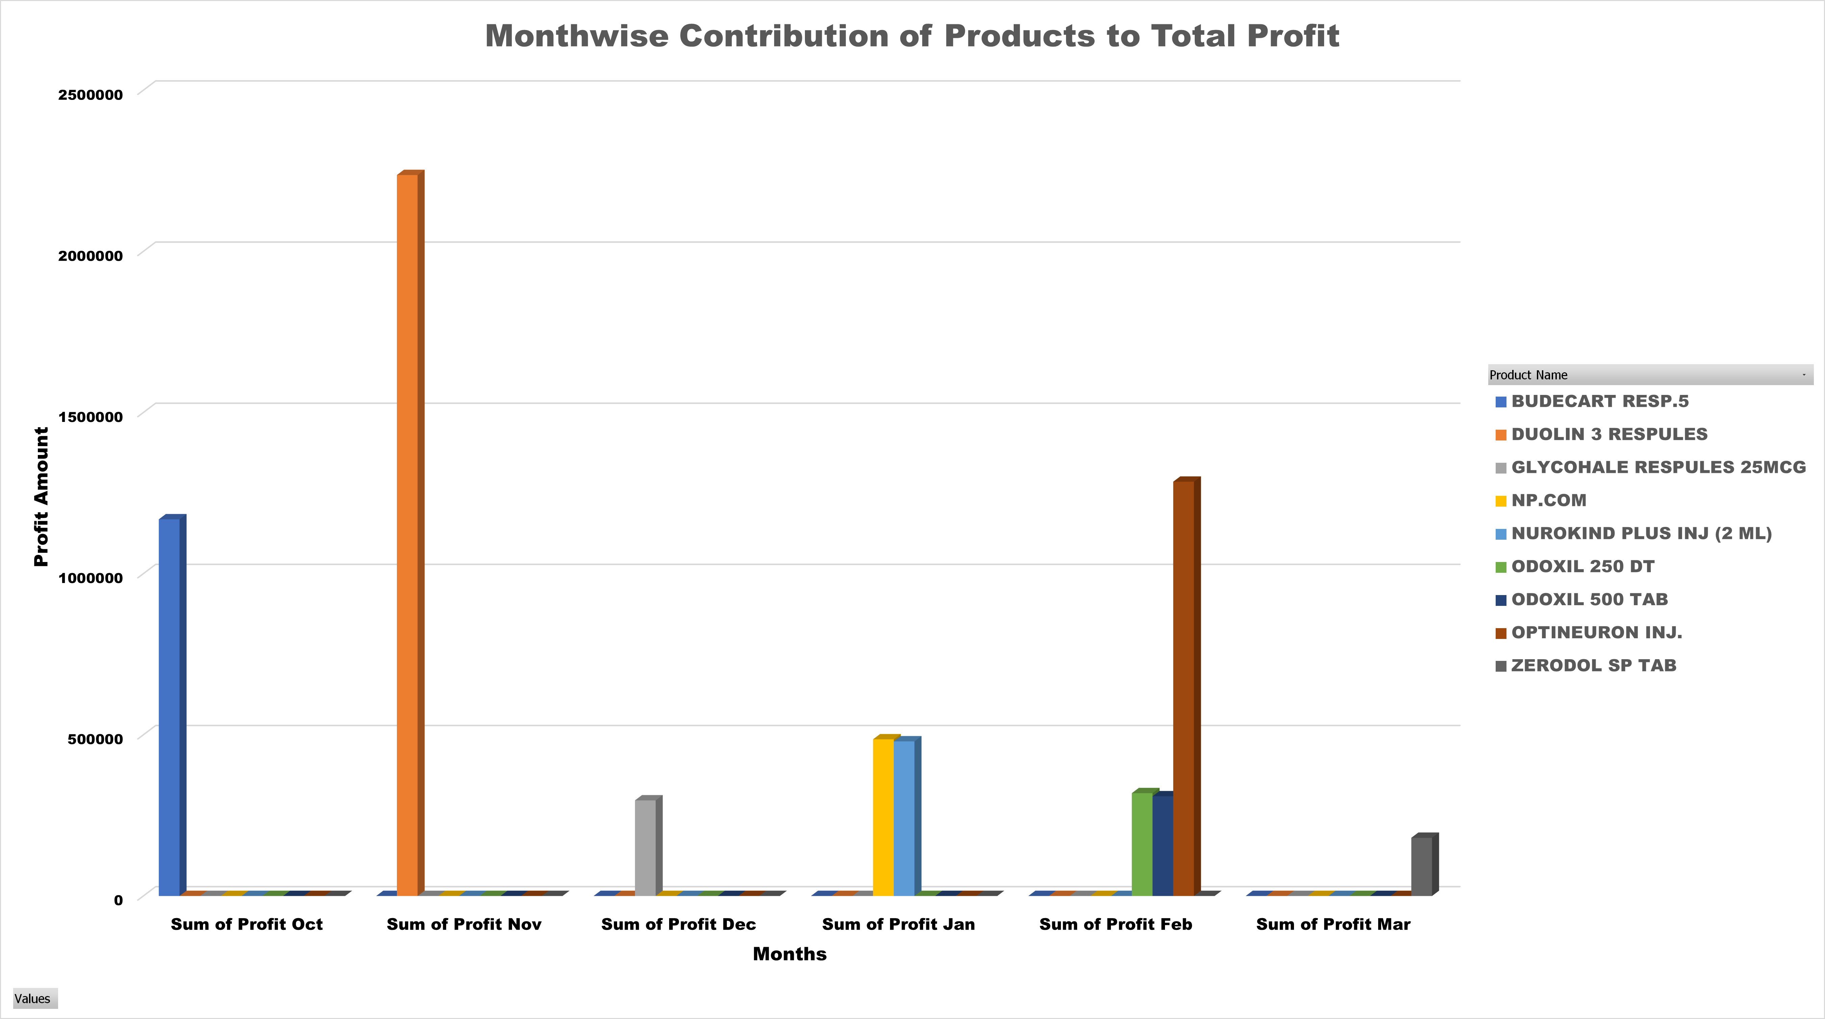
Pareto Analysis
Top Products Drive Revenue: The Pareto Analysis revealed that 20% of products, including DUOLIN 3 RESPULES and OPTINEURON INJ., generated 35% of total profits from October 2023 to March 2024.
Strategic Focus: Targeting these high-impact products can enhance revenue through optimized inventory management and targeted marketing.
Future Growth: Insights from this analysis guide resource allocation, focusing on top performers to drive future profitability.

Slide 7
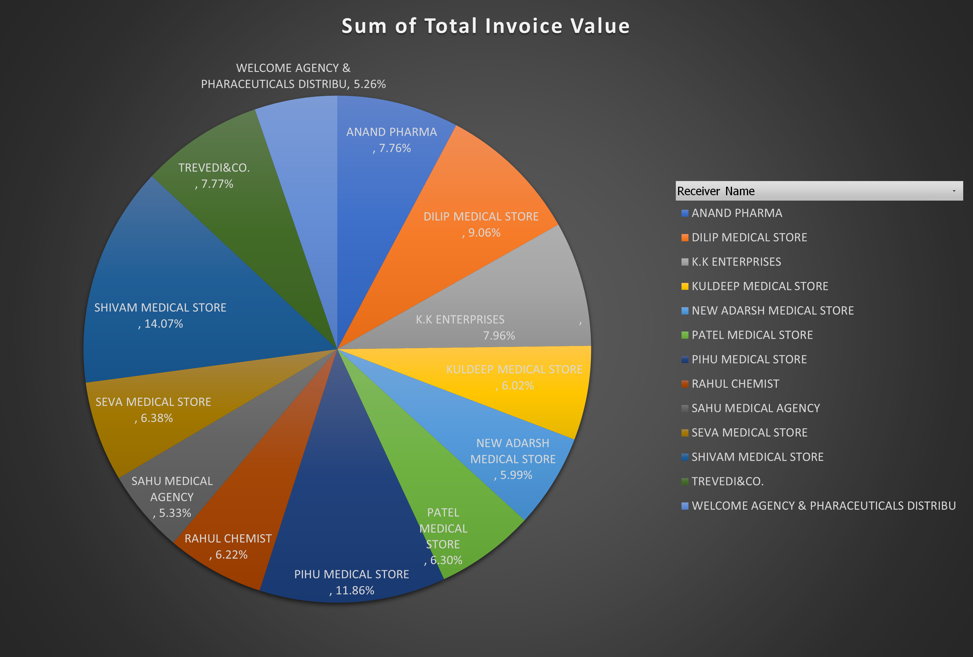
SWOT Analysis
Key Strengths: Top 13 stores, including DILIP and PIHU MEDICAL STORES, drive the most invoice value, offering a competitive advantage.
Opportunities: Expanding into emerging markets and introducing new product lines can enhance profitability and market presence.
Strategic Actions: Focus on optimizing marketing, improving supply chain efficiency, and expanding offerings to leverage strengths and capitalize on growth opportunities.

Slide 8
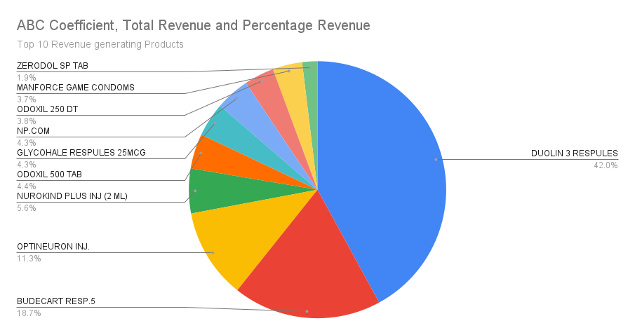
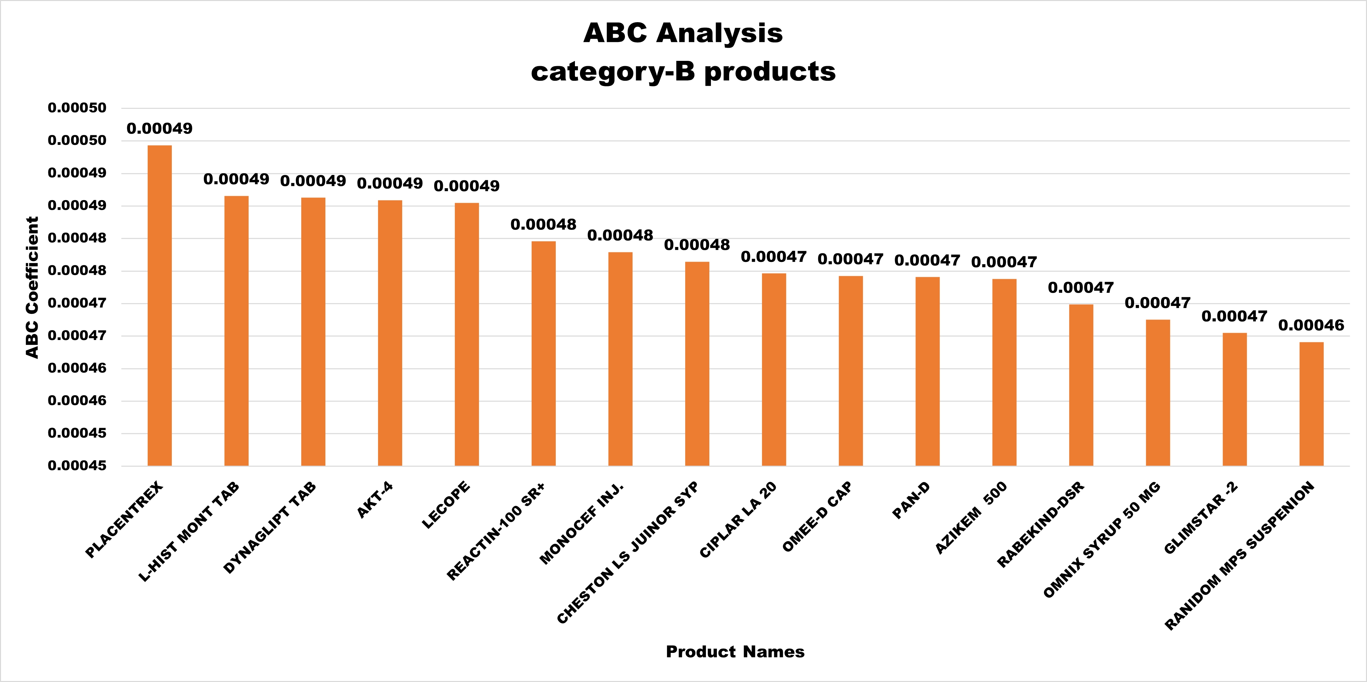
ABC Analysis
Product Segmentation: Products were classified into A, B, and C categories based on their contribution to total sales. A-category products are top performers, B-category have a moderate impact, and C-category have minimal revenue contribution.
Strategic Resource Allocation: Focus on A-category products to drive revenue, optimize inventory management, and reduce stockouts.
Tailored Marketing: Use aggressive promotion for A-category products, with targeted campaigns for B and C-category products to boost sales and profitability.

Slide 9
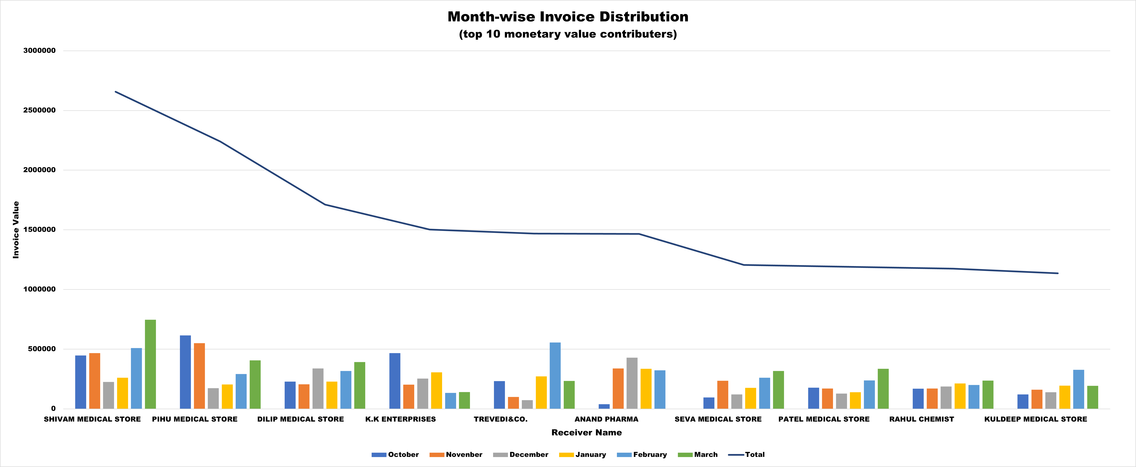
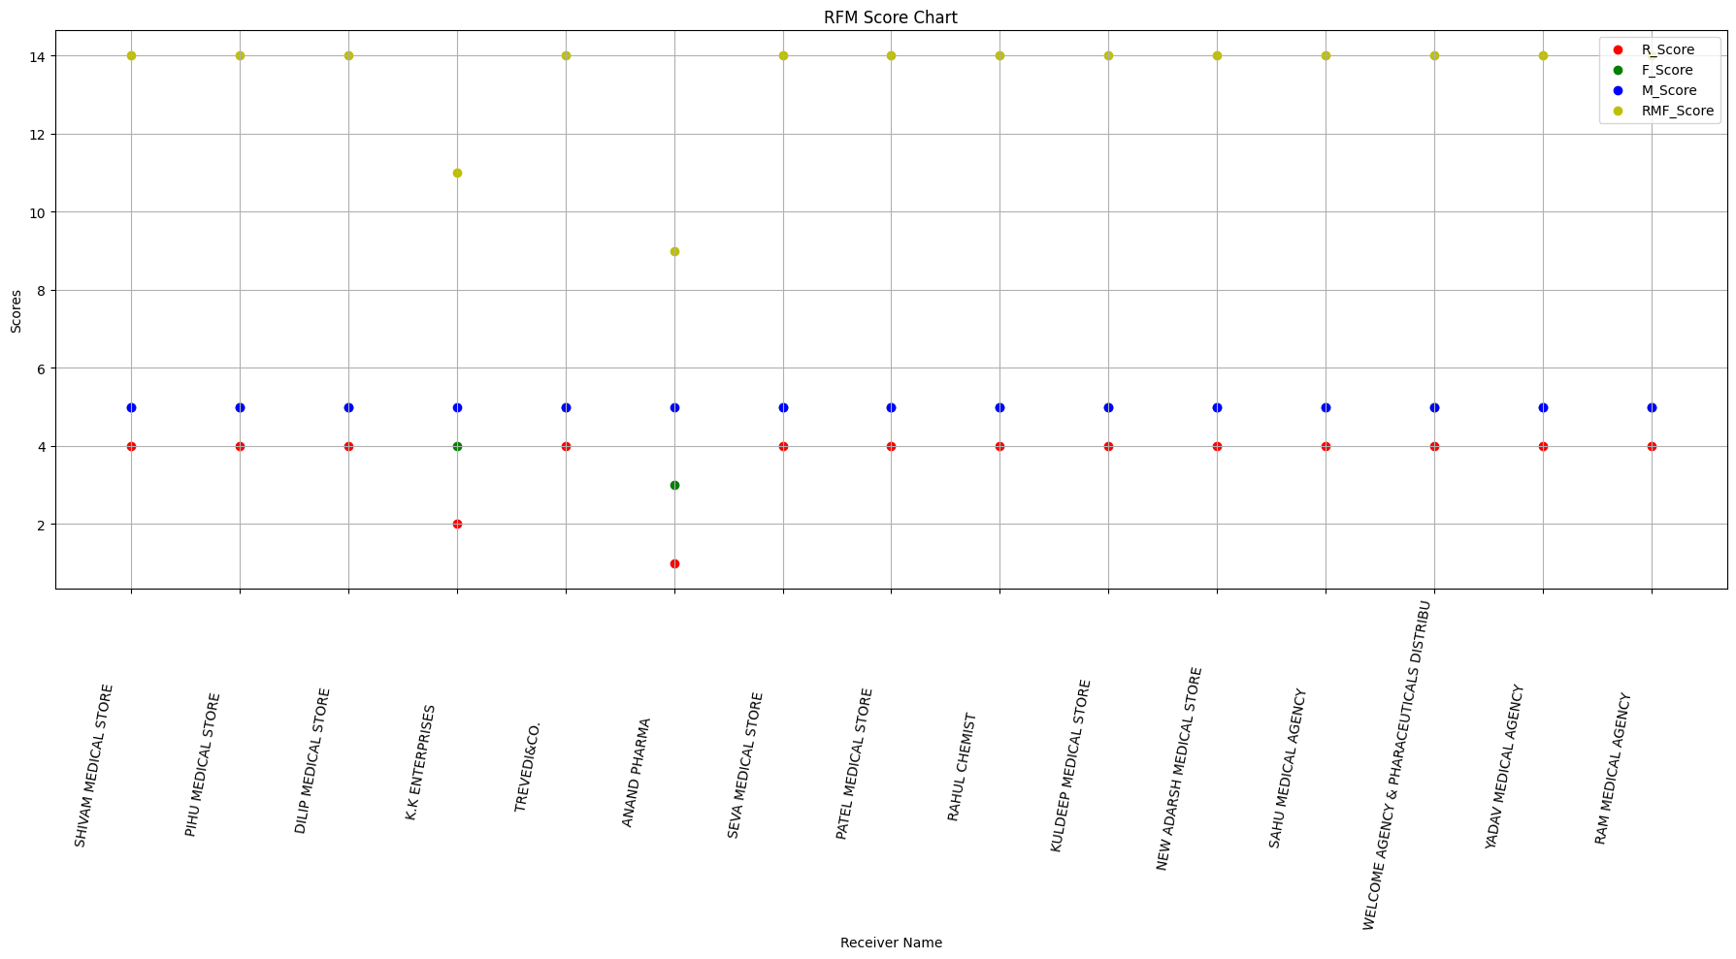
RFM Analysis
Customer Segmentation: RFM Analysis categorized stores based on their purchasing behavior—Recency, Frequency, and Monetary Value—with top clients like SHIVAM, PIHU, and DILIP MEDICAL STORES showing high engagement and value.
Tailored Strategies: High-value stores were identified for exclusive deals and loyalty initiatives, while lower-value segments were targeted with promotions to increase engagement and spending.
Strategic Insights: The analysis provided key insights into store behavior, enabling improved marketing strategies and strengthened relationships to boost growth and profitability.

Slide 10
Recommendations
Prioritize Top Buyers: Focus on high-value stores like SHIVAM, PIHU, DILIP MEDICAL STORES, and K.K. ENTERPRISES, offering personalized promotions and loyalty programs.
Enhance Customer Service: Ensure excellent service and prompt order processing to improve purchasing experiences and encourage repeat business.
Engage Low-Frequency Buyers: Target stores like CARE PHARMA with tailored discounts and promotions to increase purchase frequency.
Optimize Inventory Management: Maintain stock of top-performing products like DUOLIN 3 RESPULES through effective inventory strategies and real-time tracking.
Strengthen Supplier Relationships: Ensure timely deliveries and favorable terms by maintaining strong communication and adopting a just-in-time inventory approach.

